Slide 1
Linear Regression

Slide 2
Simple Linear Regression
Linear regression is one of the simplest and most commonly used modeling techniques. It makes very strong assumptions about the relationship between the predictor variables (the X) and the response (the Y). It assumes that this relationship takes the form:
y = β₀ + β₁x + ε
ε is normally distributed errors

Slide 3
import pandas as pd
import statsmodels.formula.api as smf
df = pd.read_csv(https://bit.ly/2HVXWqR', index_col=0)
est = smf.ols(formula='Employed ~ GNP', data=df).fit()
est.summary()

Slide 4
Dep. Variable | Which variable is the response in the model
Model | What model you are using in the fit
Method | How the parameters of the model were calculated
No. Observations | The number of observations (examples)
DF Residuals | Degrees of freedom of the residuals. Number of observations - number of parameters
DF Model | Number of parameters in the model (not including the constant term if present)

Slide 5
R-squared | The coefficient of determination. A statistical measure of how well the regression line approximates the real data points
Adj. R-squared | The above value adjusted based on the number of observations and the degrees-of-freedom of the residuals
F-statistic | A measure how significant the fit is. The mean squared error of the model divided by the mean squared error of the residuals
Prob (F-statistic) | The probability that you would get the above statistic, given the null hypothesis that they are unrelated
Log-likelihood | The log of the likelihood function.
AIC | The Akaike Information Criterion. Adjusts the log-likelihood based on the number of observations and the complexity of the model.

Slide 6
coef | The estimated value of the coefficient
std err | The basic standard error of the estimate of the coefficient. More sophisticated errors are also available.
t | The t-statistic value. This is a measure of how statistically significant the coefficient is.
P > |t| | P-value that the null-hypothesis that the coefficient = 0 is true. If it is less than the confidence level, often 0.05, it indicates that there is a statistically significant relationship between the term and the response.
[95.0% Conf. Interval] | The lower and upper values of the 95% confidence interval

Slide 7
Skewness | A measure of the symmetry of the data about the mean. Normally-distributed errors should be symmetrically distributed about the mean (equal amounts above and below the line).
Kurtosis | A measure of the shape of the distribution. Compares the amount of data close to the mean with those far away from the mean (in the tails).
Omnibus | D'Angostino's test. It provides a combined statistical test for the presence of skewness and kurtosis.
Prob(Omnibus) | The above statistic turned into a probability
Jarque-Bera | A different test of the skewness and kurtosis

Slide 8
Multivariate Regression
A linear regression expresses the relationship between a dependent variables and multiple independent variables in the following manner:
y = β₀ + β₁x₁ + β₂x₂ + β₃x₃ + … + β_{k}x_{k} + ε
So this is where k = m > 1.
And β₀ remains the intercept, while the β_{m}’s are the slope parameters.
The independent variables must not only not be purely dependent of the dependent variables, but none of the dependent variables can not purely depend on one another. Otherwise doing so will lead to multi-colinearity.
If there is independence of the dependent variable, after accounting for the modeling from the independent variables, then the error term should again be an identical random normal variable.

Slide 9
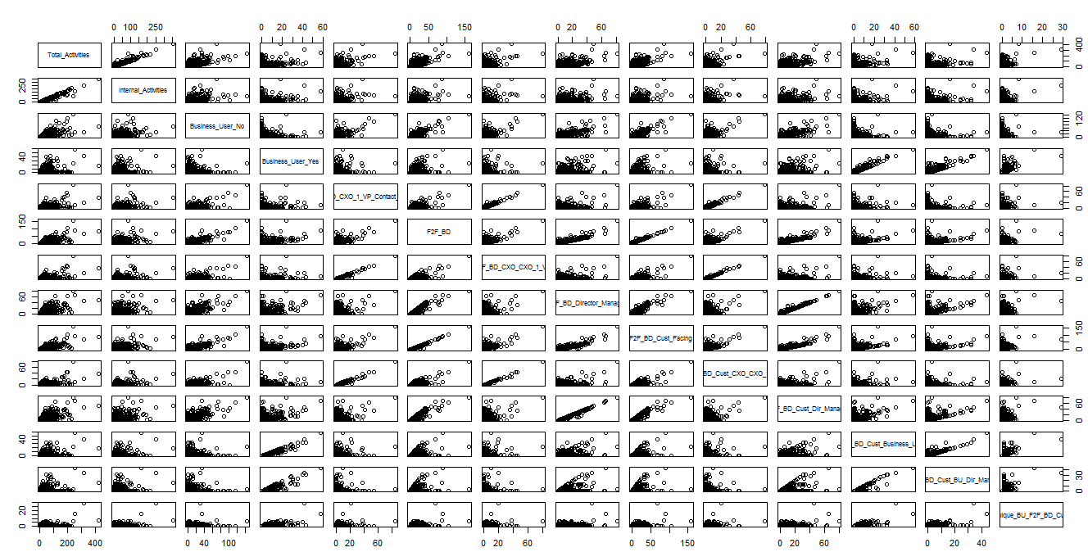
Multicollinearity

Slide 10
Linear Regression Pitfalls
Not having linear relationships.
Some of the predictor variables may need to be transformed (ex., age and age-squared) or a non-linear link function may need to be used which transforms the outcome variable.
Having a binary (0/1) dependent variable.
This violates the assumption dependent variable be normally distributed. Try logistic regression instea.
Heterogenous effects across levels of the dependent variable.
OLS regression predicts average effects. If effects differ for different parts of the range of the dependent variable, the mean will be a "bad average". Consider quantile regression.
Heteroscedastic residuals.
If error is not homogenous along the range of the dependent variable, …

Slide 11
Linear Regression Pitfalls
Mis-specifying the model.
Significant variables are omitted or spurious but correlated variables are included.
Lack of sampling adequacy across feature space.
Curse of dimensionality!
Using stepwise regression for confirmatory purposes.
This leads to overfitting the data and may not generalize to future datasets. If used, it should be for exploratory research and, ideally, results should be cross-validated using a validation dataset.
Asserting that a regression model is true.
Multiple models may generate model fit as good or better. Only compare among models to see which fits better.

